Slide 1
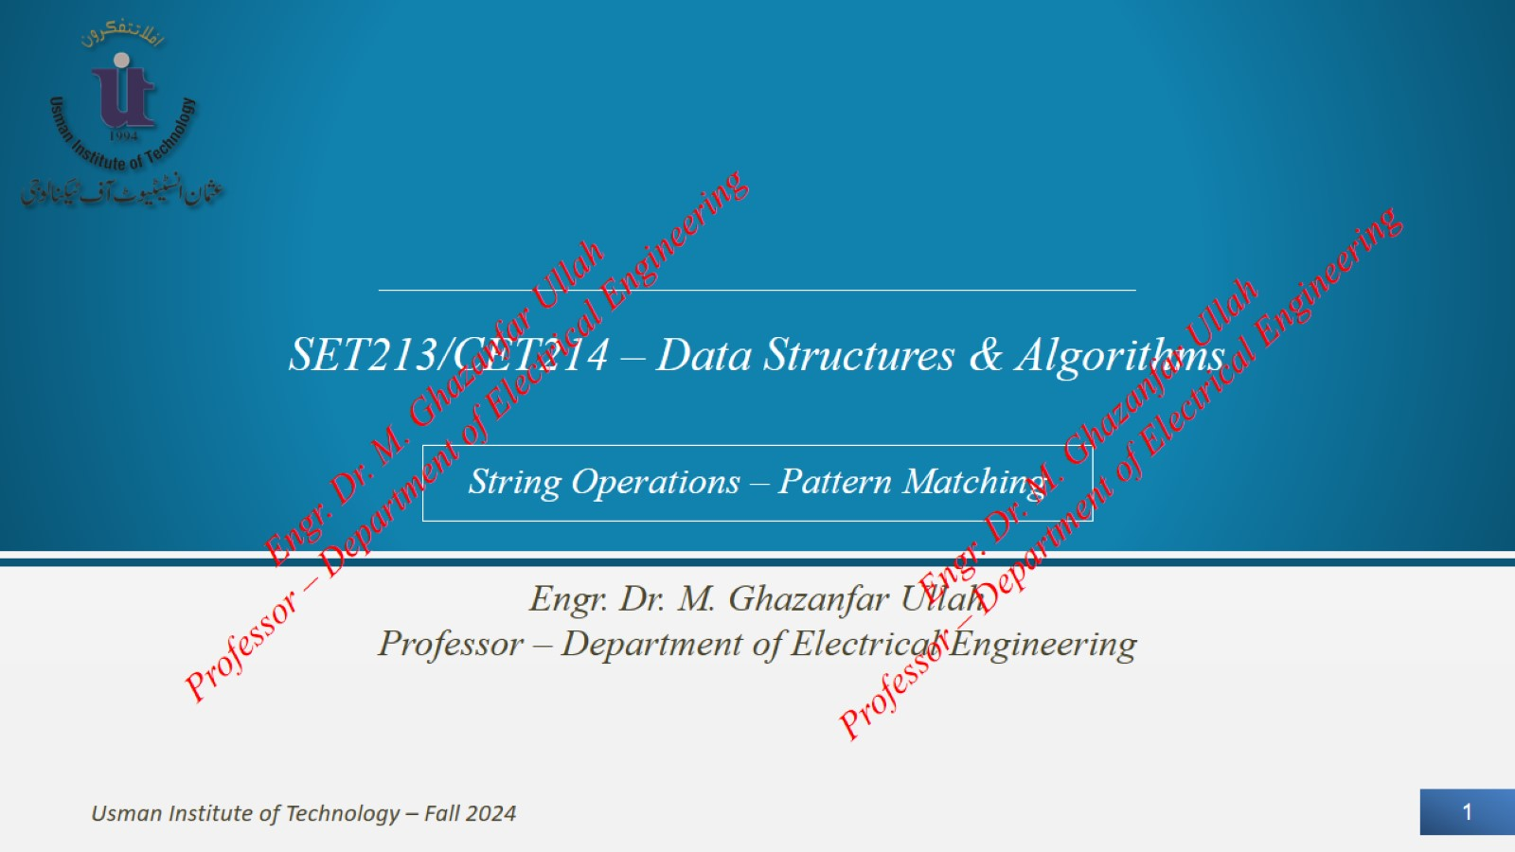

Slide 2
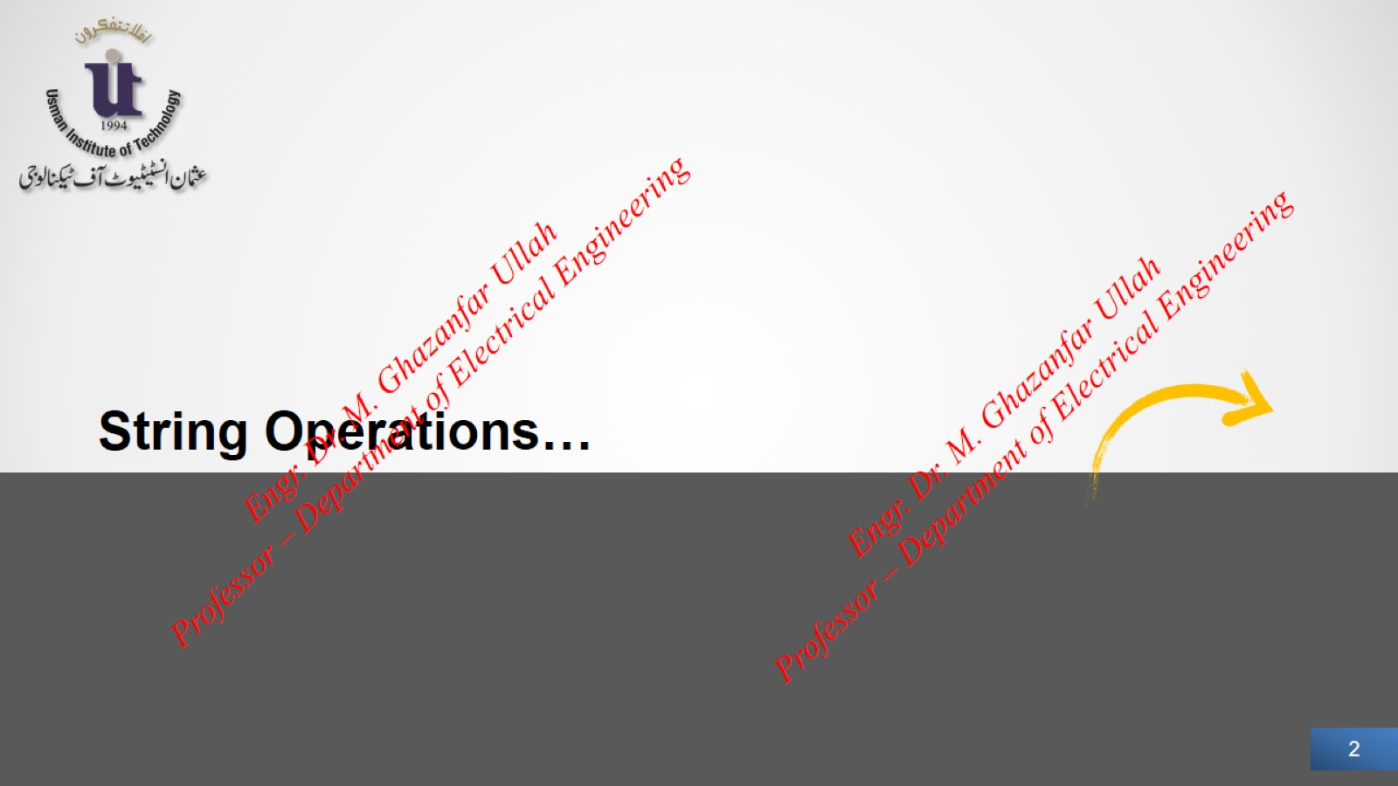

Slide 3
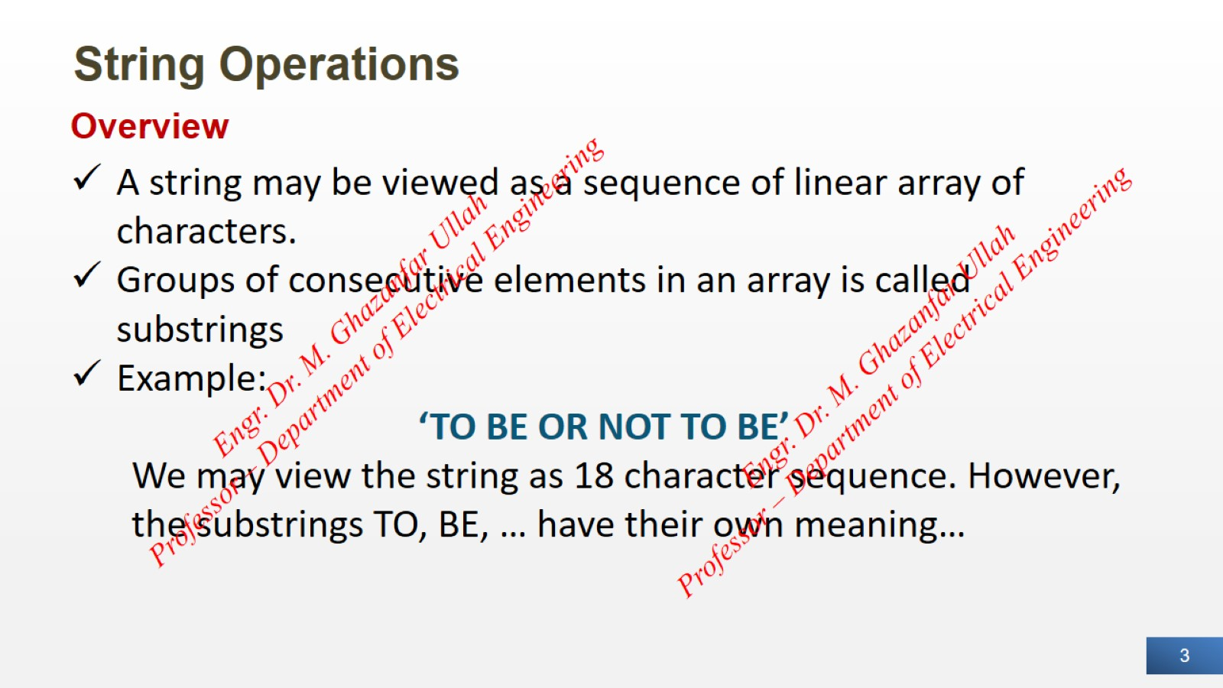
String Operations

Slide 4
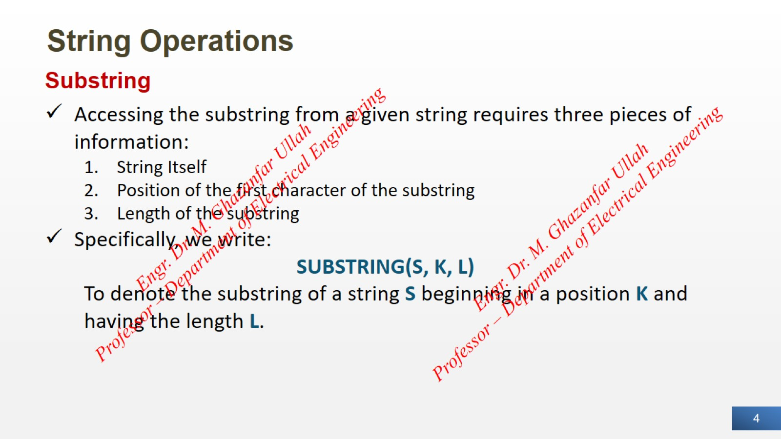
String Operations

Slide 5
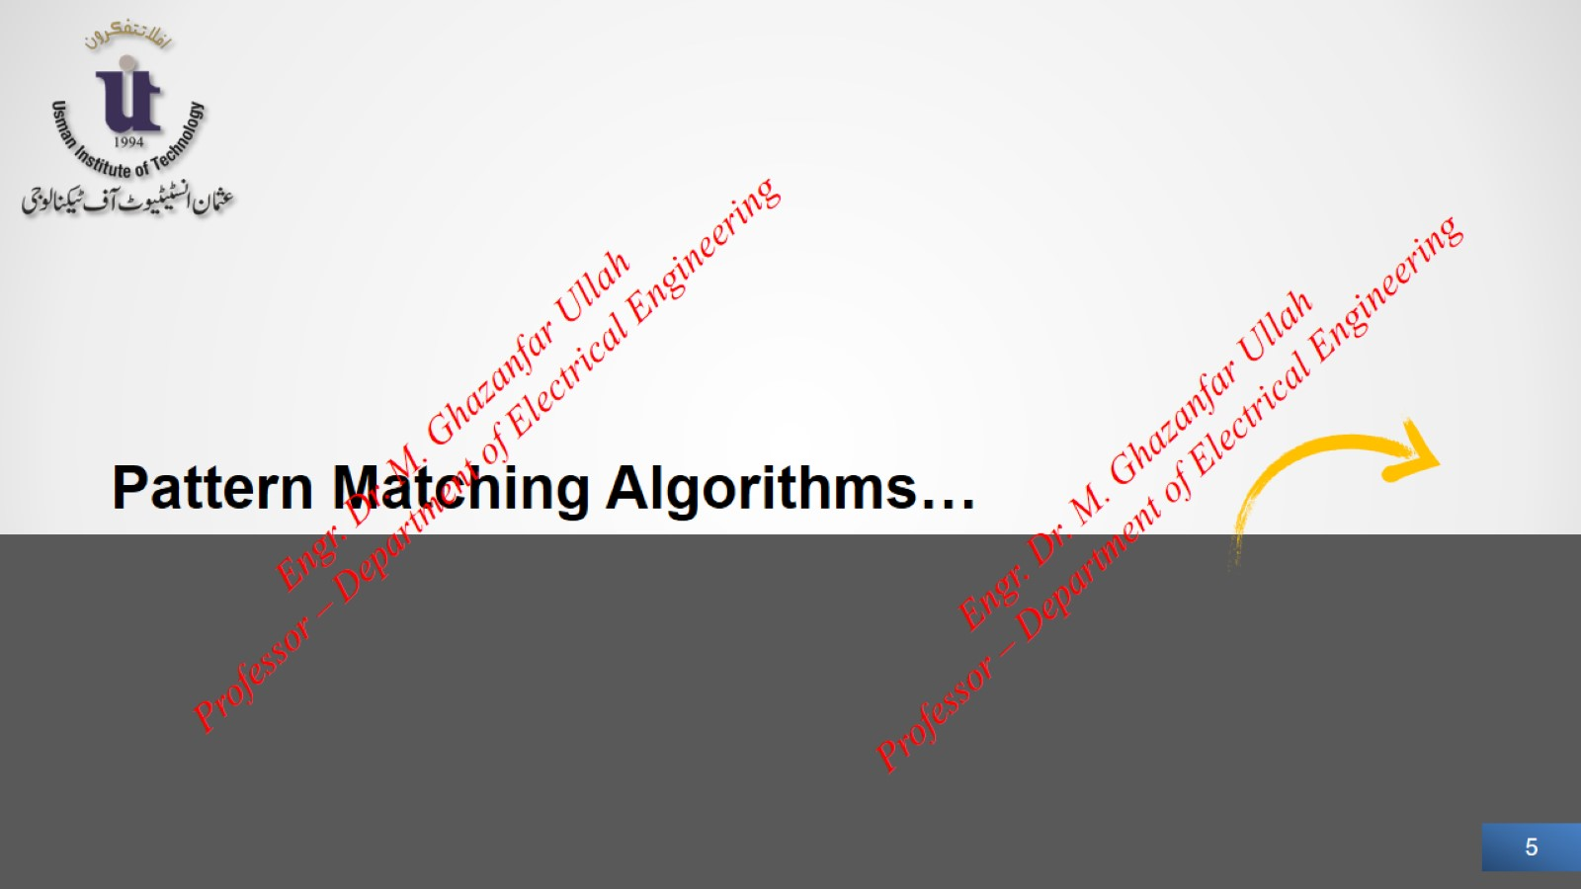

Slide 6
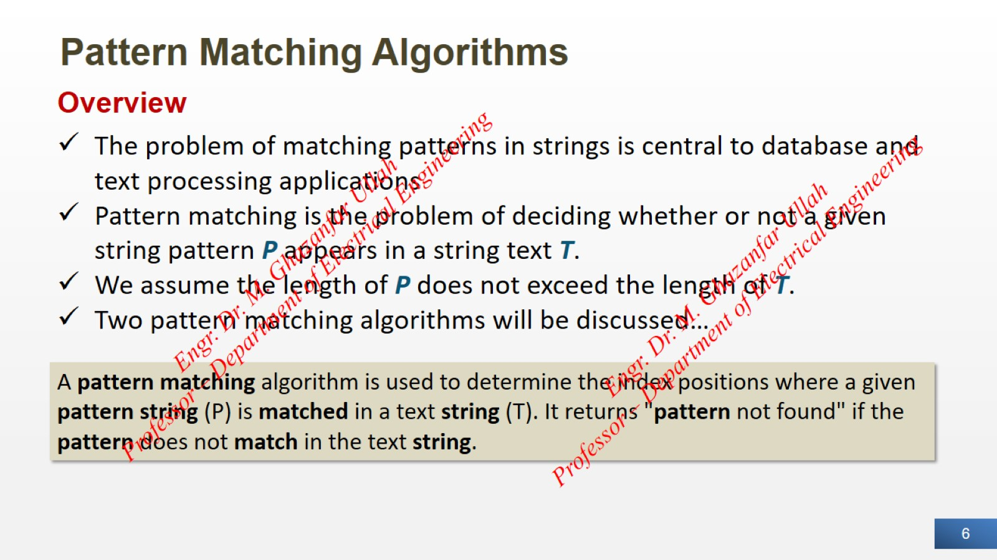
Pattern Matching Algorithms

Slide 7
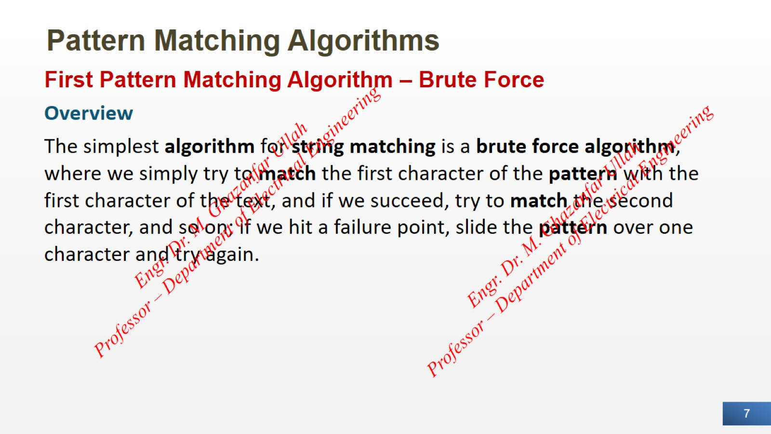
Pattern Matching Algorithms

Slide 8
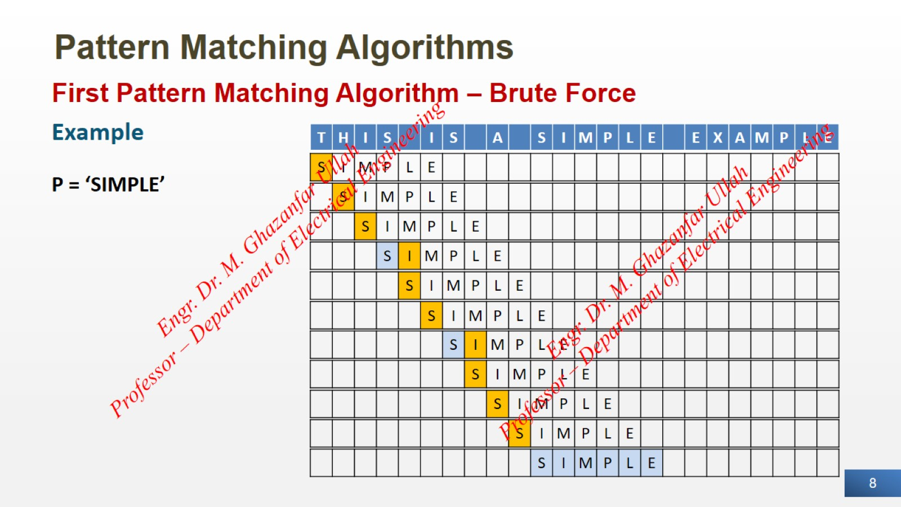
Pattern Matching Algorithms

Slide 9
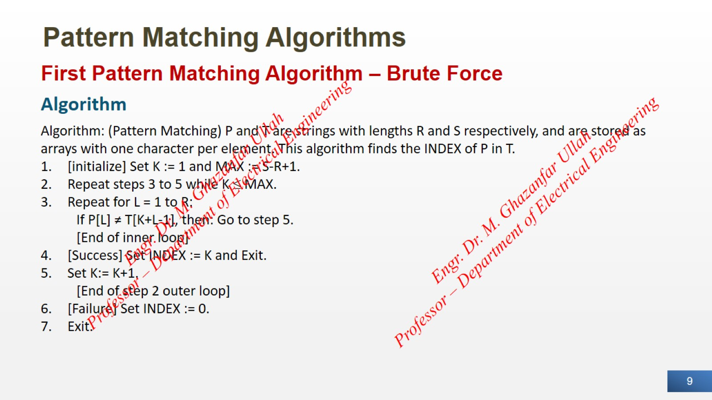
Pattern Matching Algorithms

Slide 10
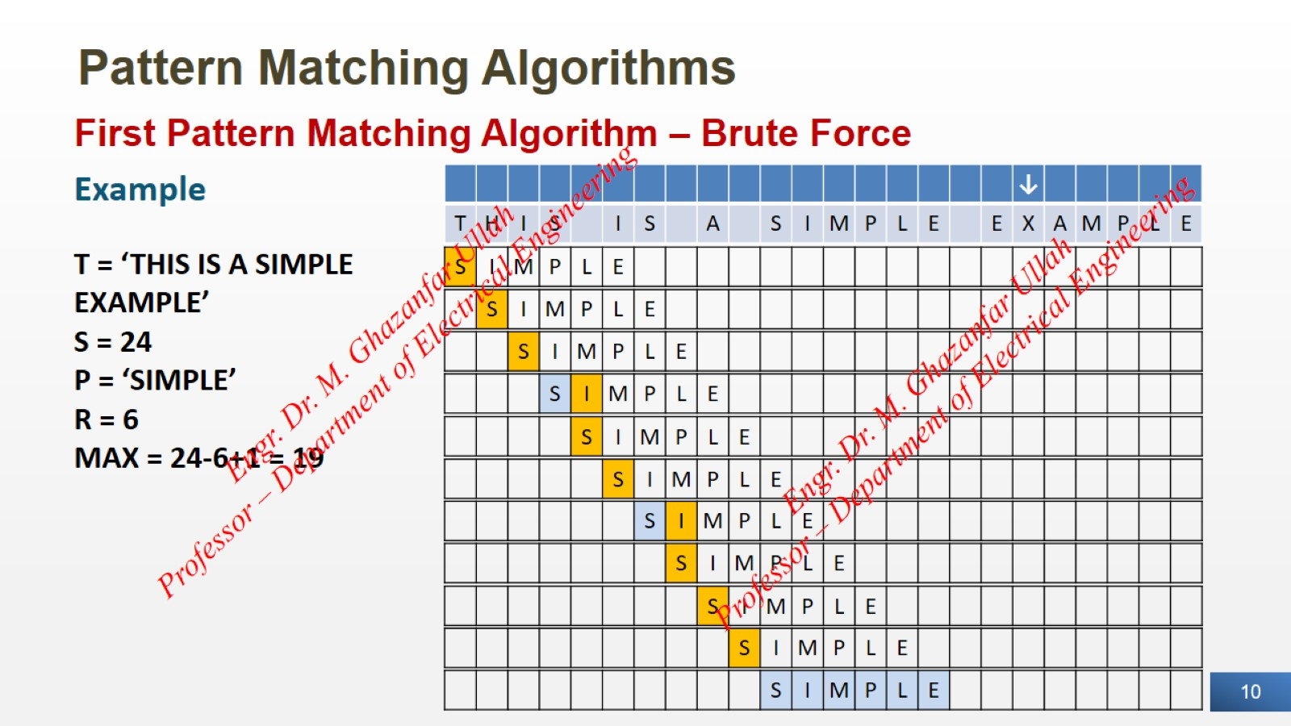
Pattern Matching Algorithms

Slide 11
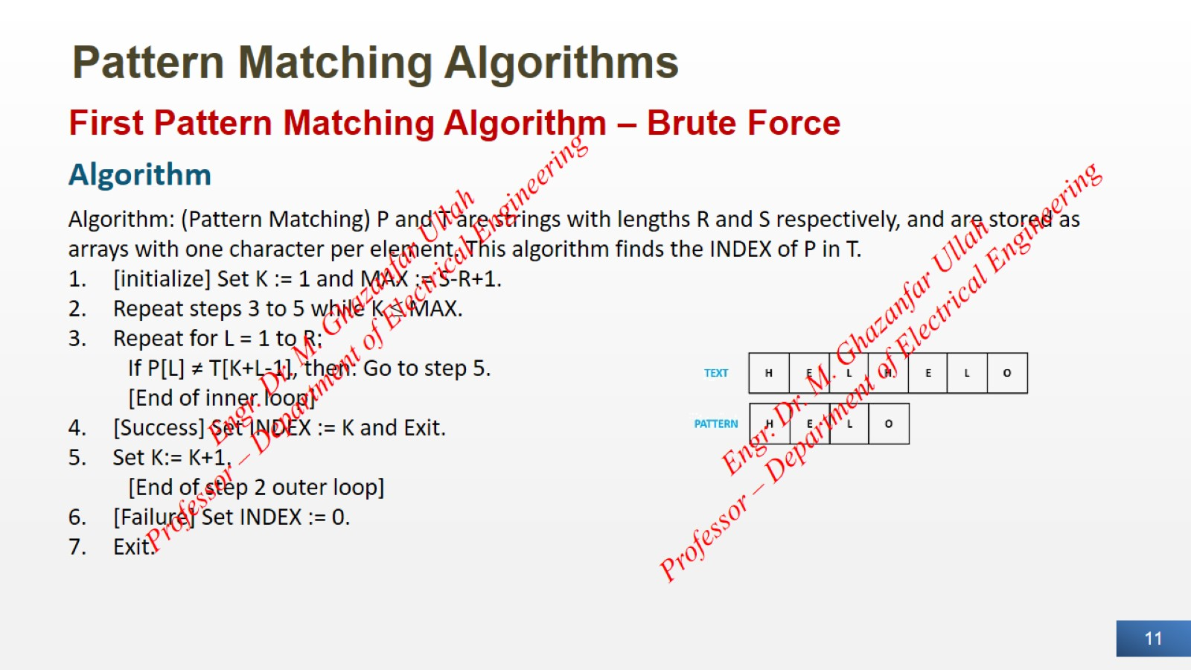
Pattern Matching Algorithms

Slide 12
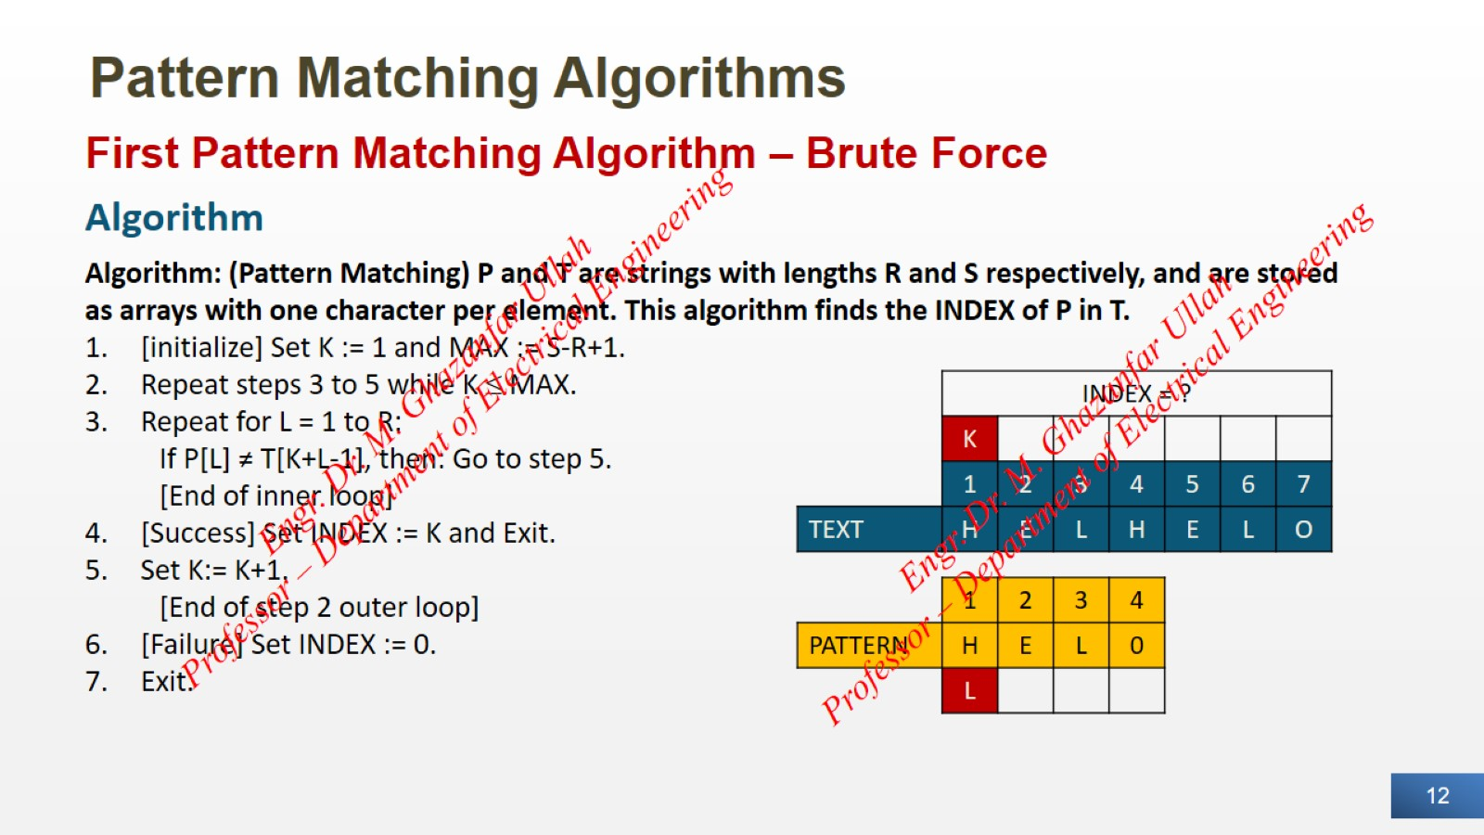
Pattern Matching Algorithms

Slide 13

Pattern Matching Algorithms

Slide 14
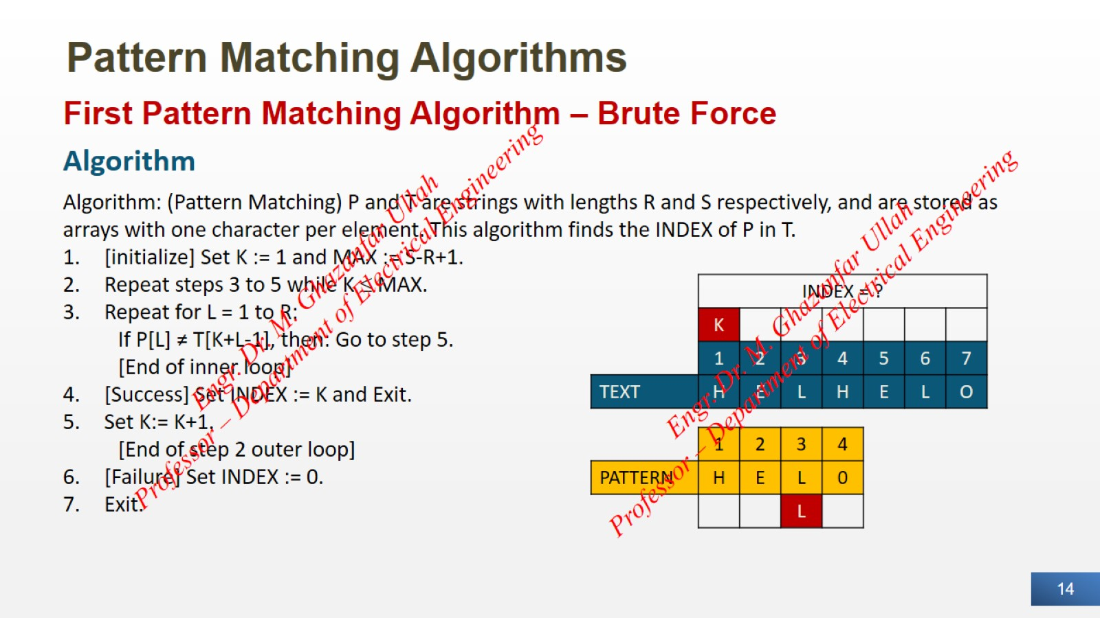
Pattern Matching Algorithms

Slide 15

Pattern Matching Algorithms

Slide 16
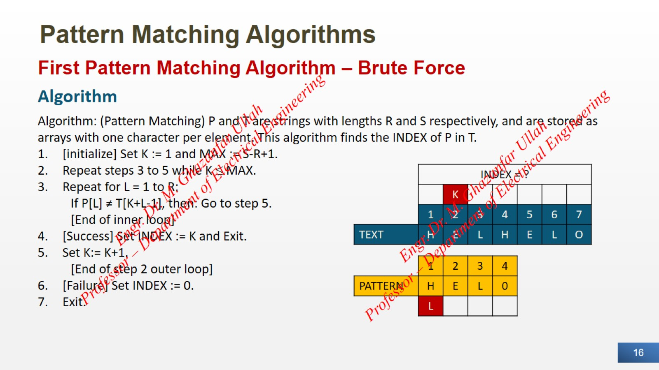
Pattern Matching Algorithms

Slide 17

Pattern Matching Algorithms

Slide 18
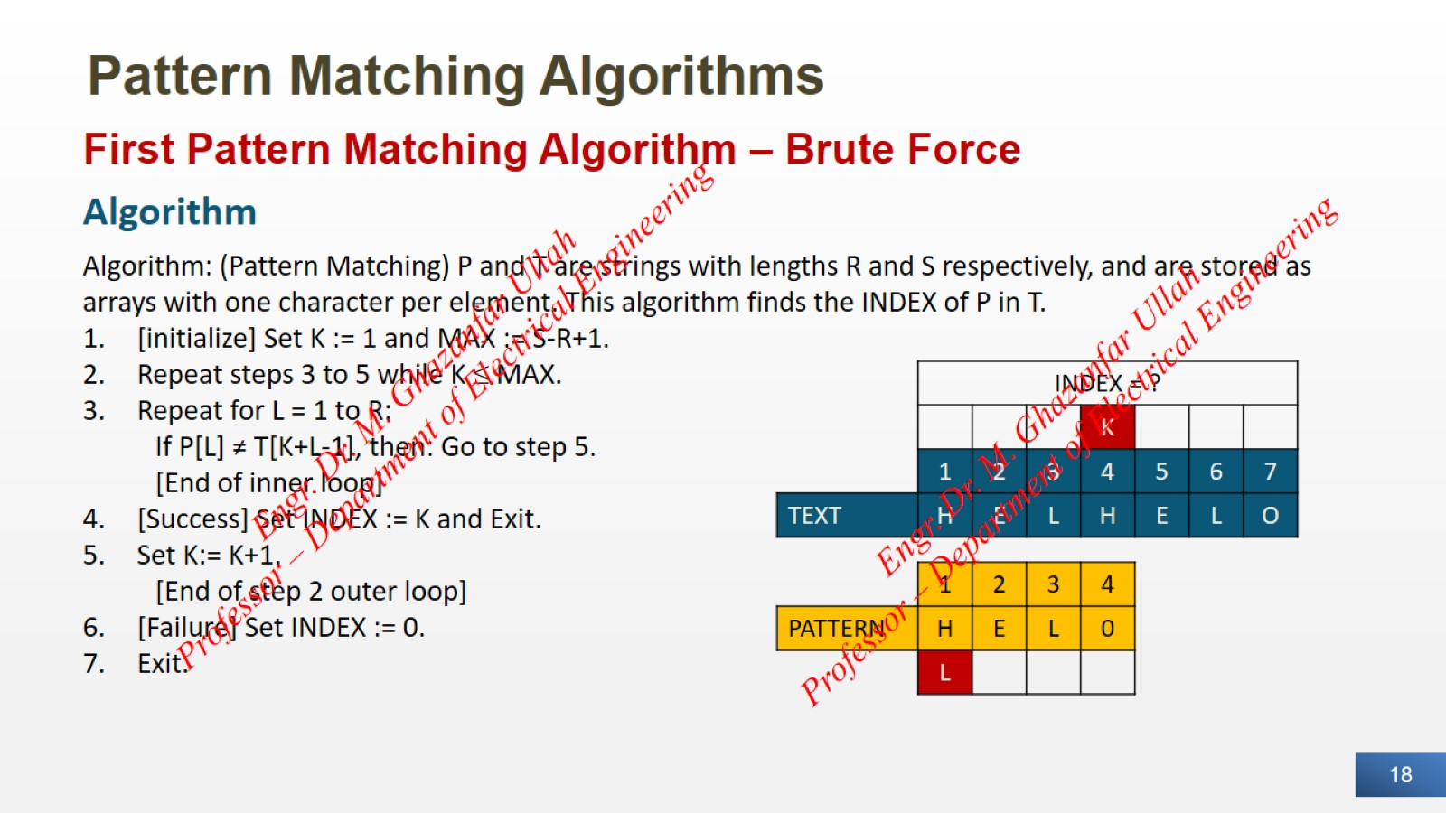
Pattern Matching Algorithms

Slide 19
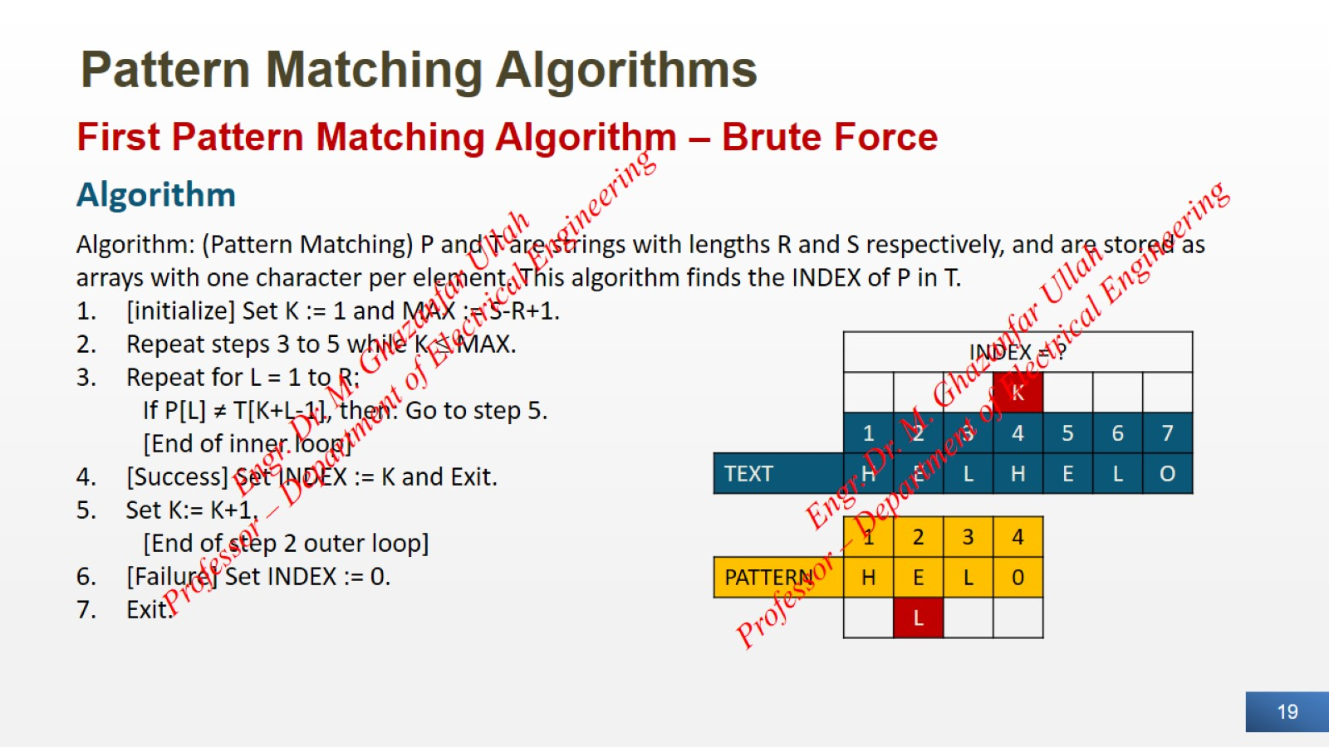
Pattern Matching Algorithms

Slide 20

Pattern Matching Algorithms

Slide 21
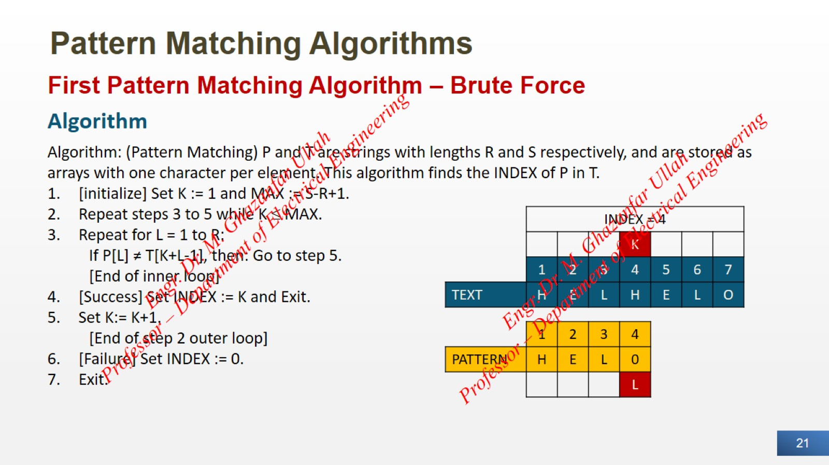
Pattern Matching Algorithms

Slide 22
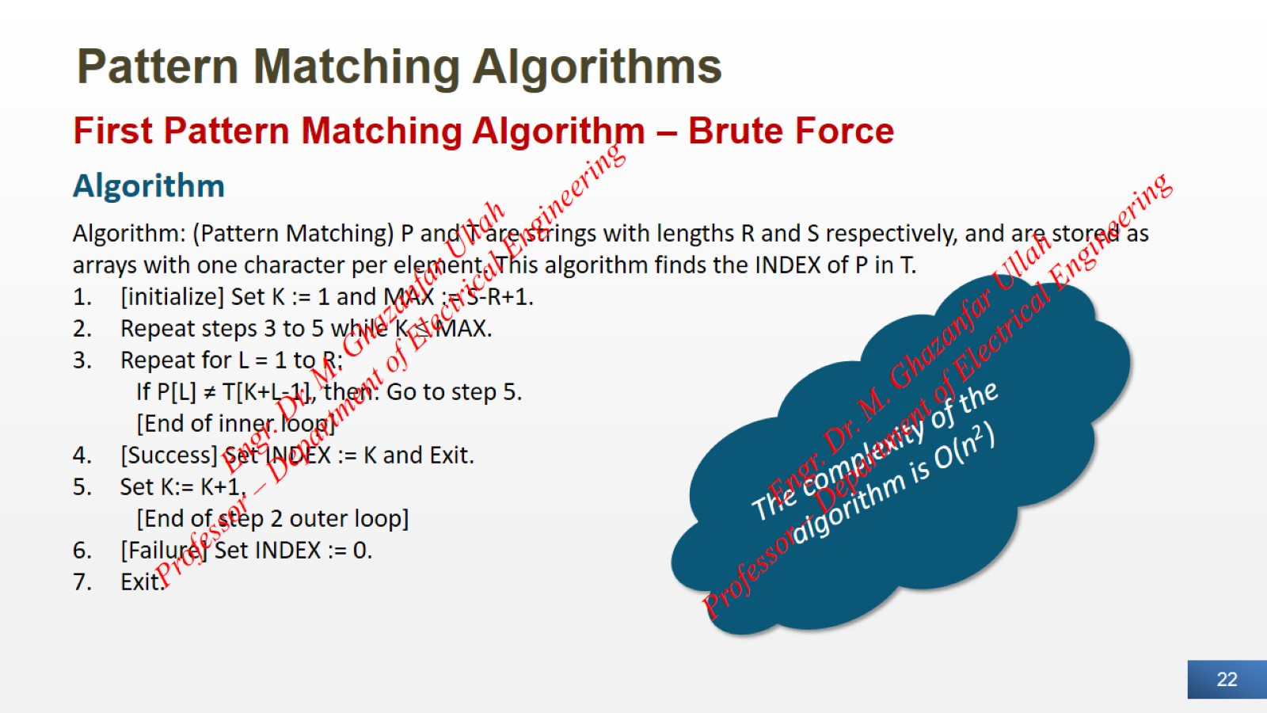
Pattern Matching Algorithms

Slide 23
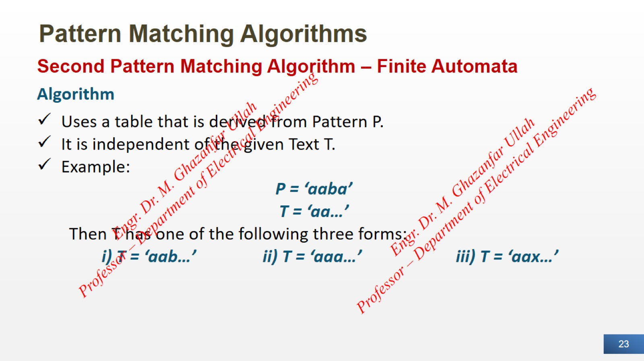
Pattern Matching Algorithms

Slide 24
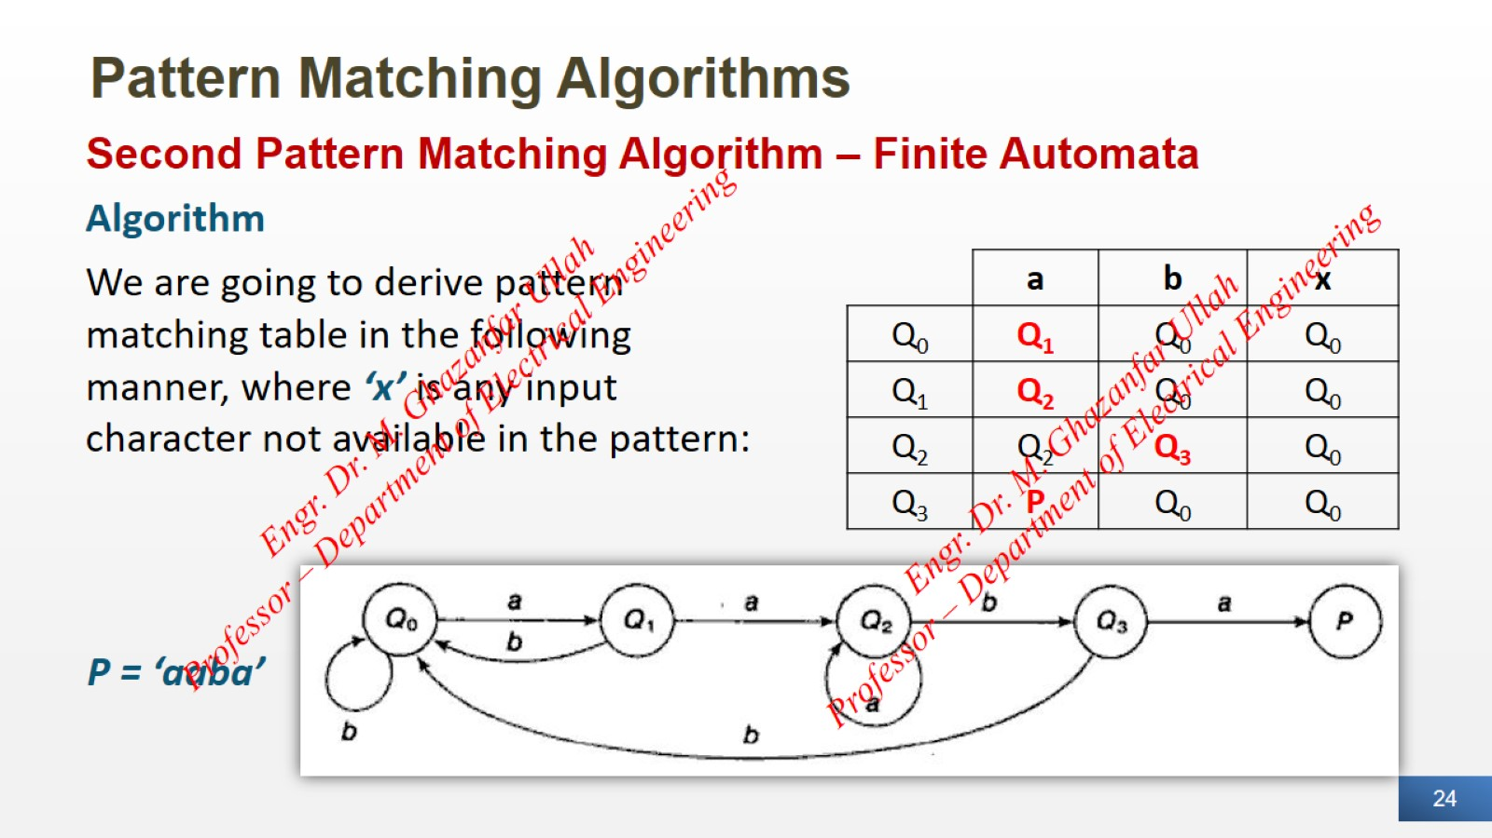
Pattern Matching Algorithms

Slide 25
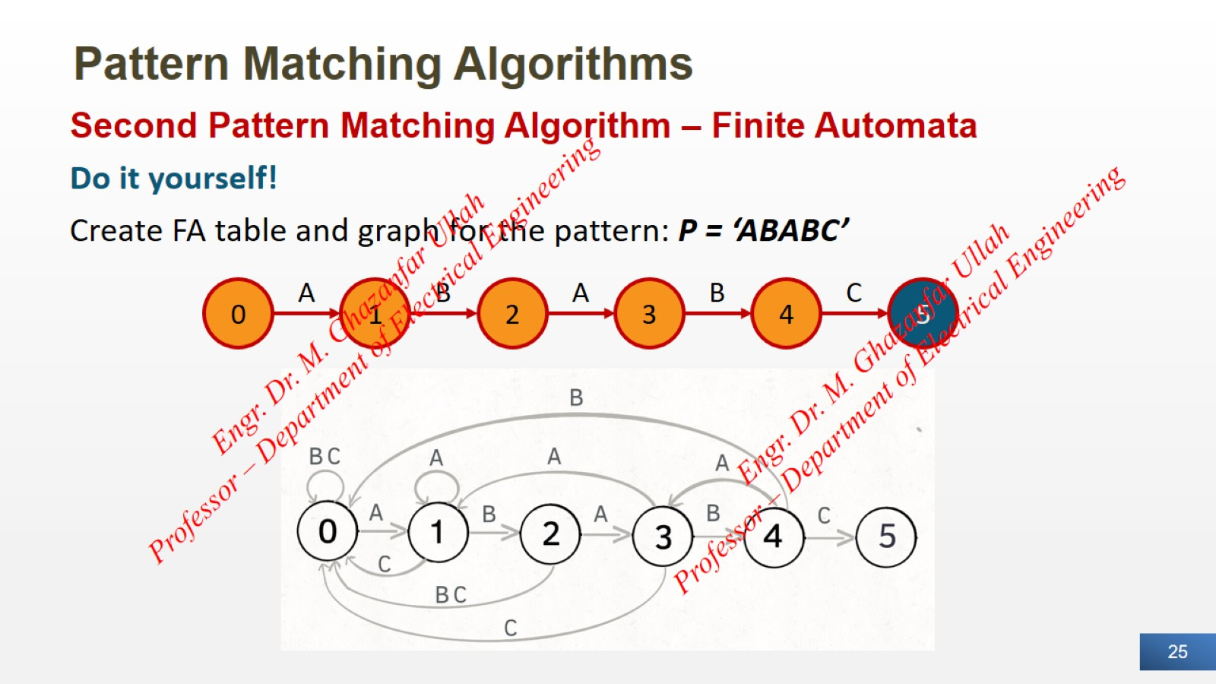
Pattern Matching Algorithms

Slide 26
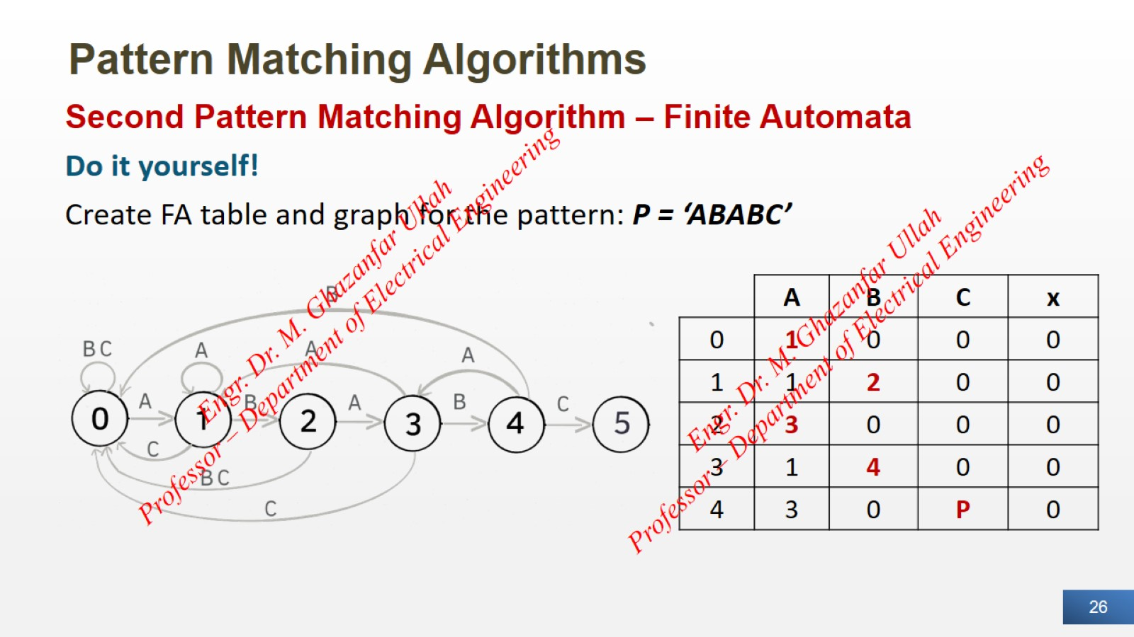
Pattern Matching Algorithms

Slide 27
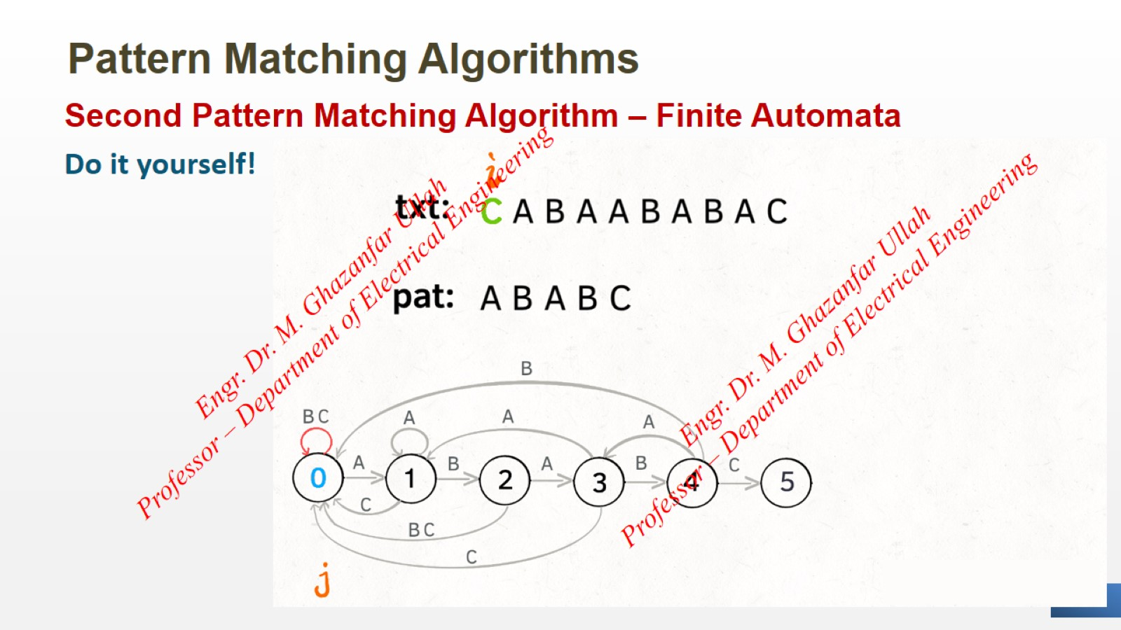
Pattern Matching Algorithms

Slide 28
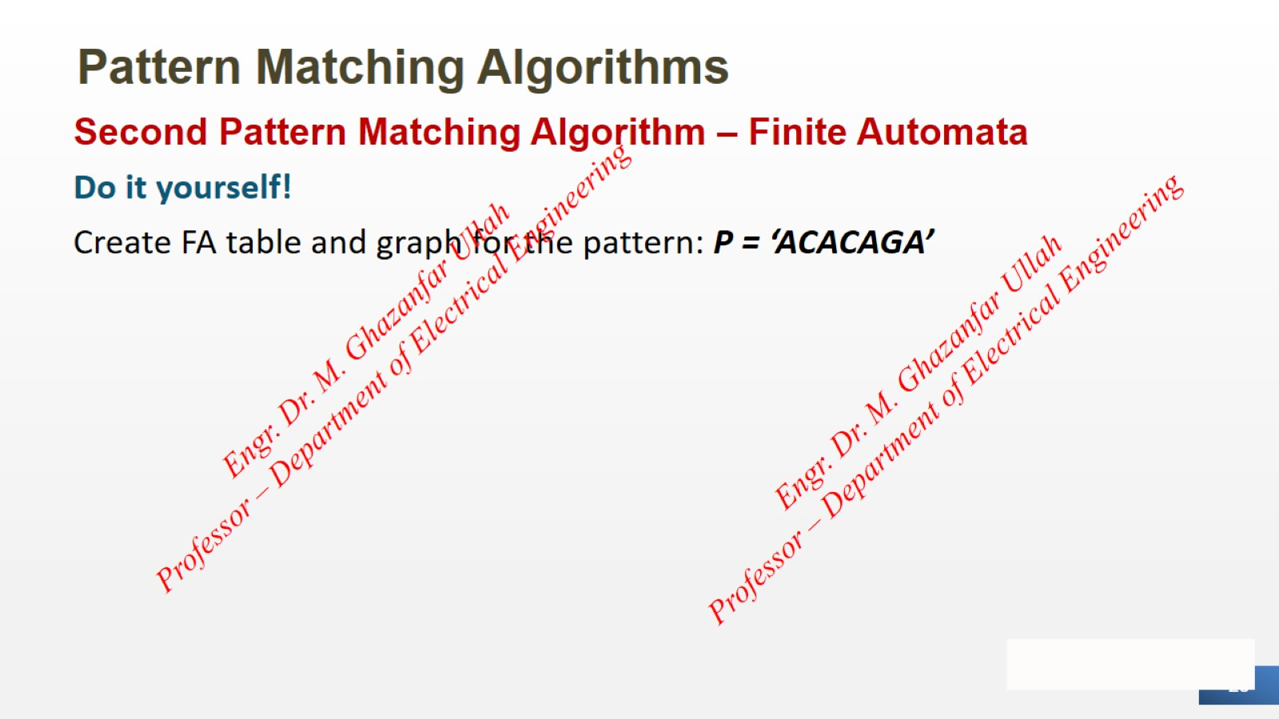
Pattern Matching Algorithms

Slide 29


